Slide 1
Graphical & Diagrammatic Representation of Data
Presented by
Dr. Manjiree Vyawahare

Slide 2
Graph
Graphs are also called as a charts..
Graphs are incredibly useful tools in Excel
It is very easy to add them to your spreadsheets
Graphs are helpful to tell a visual presentation of data
Therefore, it is important to learn how to make graphs

Slide 3
Building a chart in Excel
Is not a difficult task……
Set you mind for…which types of chart to use in which situation
Excel has 11 major chart types with sub types in each type
Excel, including the following types of charts
Line charts
Bar charts
Pie charts
Etc…….

Slide 4
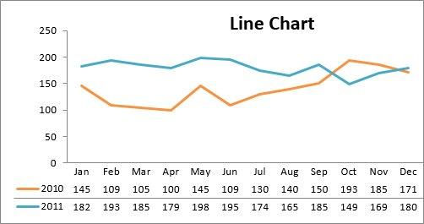
Line Chart
The line chart is one of the most frequently used chart types, typically used to show trends over a period of time.
If you need to chart changes over time, consider using a line chart.

Slide 5
Column Chart:
Column charts are typically used to compare several items in a specific range of values.
Column charts are ideal if you need to compare a single category of data between individual sub-items, such as, for example, when comparing revenue between regions.

Slide 6
Clustered Column Chart:
A clustered column chart can be used if you need to compare multiple categories of data within individual sub-items as well as between sub-items. For instance, you can use a clustered column chart to compare revenue for each year within each region, as well as between regions.

Slide 7
Stacked Column Chart
A stacked column chart allows you to compare items in a specific range of values as well as show the relationship of the individual sub-items with the whole. For instance, a stacked column chart can show not only the overall revenue for each year, but also the proportion of the total revenue made up by each region.

Slide 8
Pie Chart
Another frequently used chart is the old pie chart. A pie chart represents the distribution or proportion of each data item over a total value (represented by the overall pie).

Slide 9
Bar Chart
Bar charts are typically used to compare several categories of data. Bar charts are ideal for visualizing the distribution or proportion of data items when there are more than three categories. For instance a bar chart could be used to compare the overall revenue distribution for a given set of products

Slide 10
Area Chart
Area charts are ideal for clearly illustrating the magnitude of change between two or more data points. For example, you can give your audience a visual feel for the degree of variance between the high and low price for each month.

Slide 11
XY Scatter Plot Chart
Scatter charts in Excel (also known as XY scatter plot charts) are excellent for showing correlations between two sets of values.
For example an XY scatter plot can be used to illustrate the correlation between employee performance and competency, demonstrating that employee performance rises as competency improves. The x and y axes work together to represent data plots on the chart based on the intersection of x values and y values.

Slide 12
Bubble Chart
A bubble chart is a variation of an XY scatter plot. Just like the XY scatter plot, bubble charts show the correlation between two sets of data.

Slide 13
Creating Graph in Excel
Enter your data into the Excel spreadsheet in table format.
Your data should have column headers, row headers.
In Excel, "columns" refer to vertical depth.
The columns are labeled with letters, "A," "B," "C," etc.
"Rows," on the other hand, refer to horizontal distance. They are labeled with numbers, "1," "2," "3," etc.

Slide 14
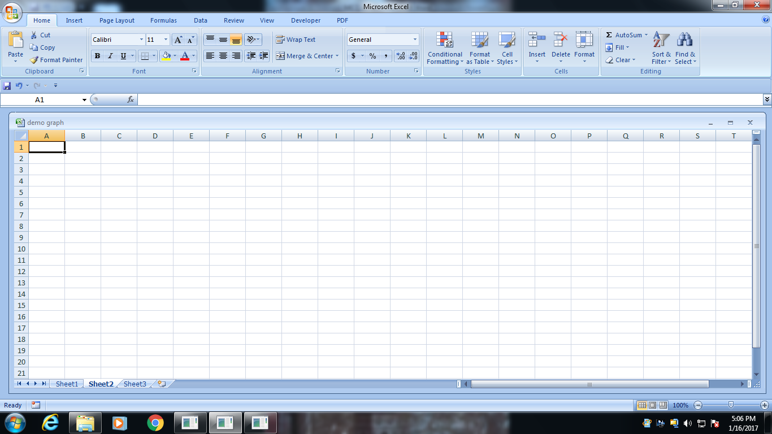
First Screen Of Worksheet
Columns
Rows

Slide 15
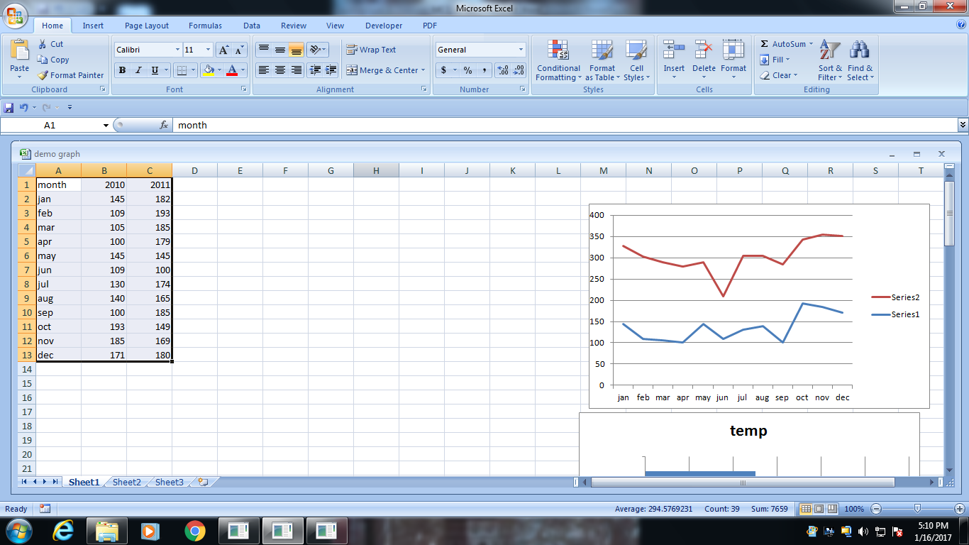

Slide 16
With your cursor, highlight the cells that contain the information that you want to appear in your graph.
If you want the column labels and the row labels to show up in the graph, ensure that those are selected also.
click Insert → Chart
you can also try navigating to the Charts tab in the Ribbon tab and selecting the specific kind of graph you'd like to use.
This will create your a graph on a “chart sheet.”
A chart sheet is basically a spreadsheet page within a workbook that is totally dedicated to displaying your graph.
For Windows users, you can create a graph with a shortcut by hitting the F11 button on your keyboard.

Slide 18
Change Your Graph
Change your graph to fit your needs.
Select the perfect kind of graph depending on what information you have and how you want to present it
Change your chart on the Chart toolbar, which appears after your chart is created.
Manipulate the chart types in the Chart Layout tab in the Ribbon tab.

Slide 19
Add chart Title
Give your chart a title. Click on the "Chart Title" button in the Ribbon tab and select whether you want your title to overlap the graph or to sit solidly above it.
Give your graph a useful name
“Selection Criteria of Male & Female in 2016”
“ Students appeared for PET in last two years”
“Passing Percentage of girls in PET in last two years”

Slide 20
Axsi title
Pay attention to axis titles.
What does your x-axis represent, and how about your y-axis?
If you don't pay attention to labeling your chart's axes, it's like you're creating a novel without chapters or an instruction manual without pictures.

Slide 21
Chart Legend
Pay attention to the chart's legend. The legend is the sort of glue that holds a chart together.
Without a legend, you're unlikely to know what the graph means because you won't know what information is plotted on the graph.
When you create a chart, Excel creates a legend by default
Your legend will be the column and row headers that you highlighted in the beginning while creating your graph.
Changing any column and row headers in their cells automatically changes their representation in the legend.

Slide 22
Switch the Graphs Rows & columns
Learn how to change your graph by switching the plotting.
Suppose you've accidentally input your information into the wrong cells, and your rows are mixed up with your columns
Instead of inputting the information all over again, simply find the "Data" subsection in the Charts tab (in the Ribbon tab) and press either "plot series by row" or "plot series by column."

Slide 23
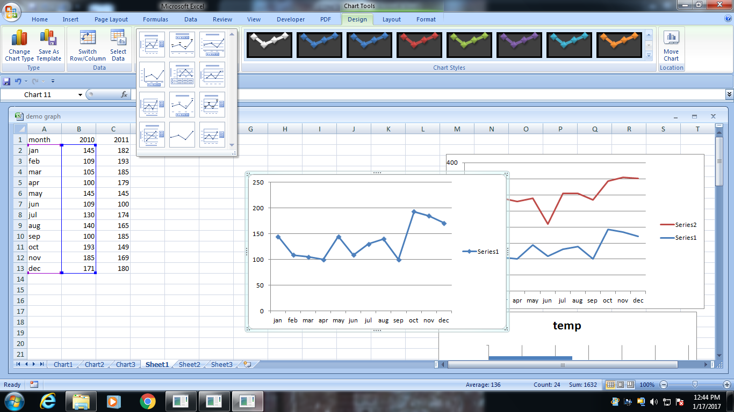
Change the Layout of chart
Chart Layout and chart style helps you to decorate your chart with different layouts and color combinations

Slide 24
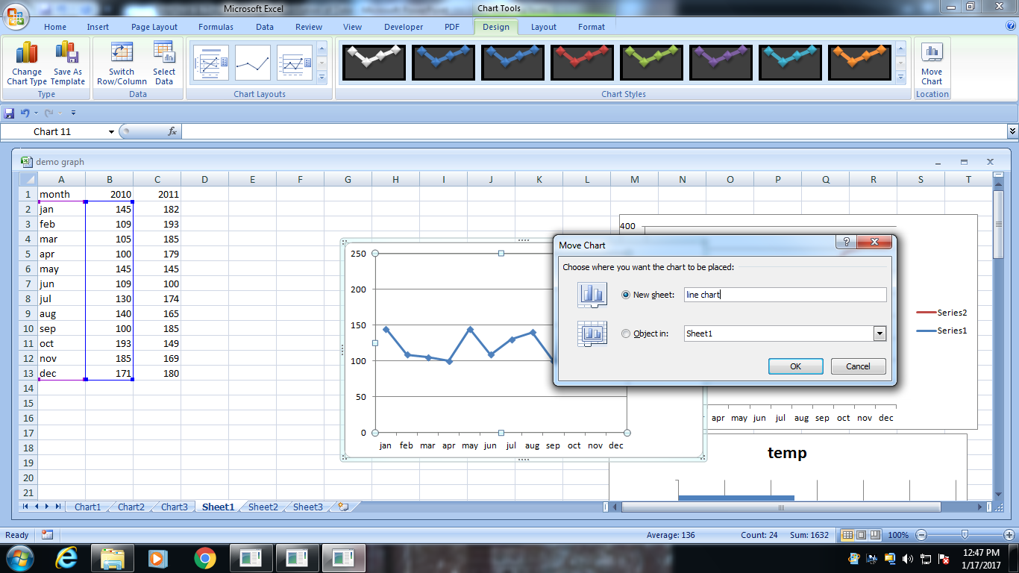
Save your chart at different location
By default chart is stored on same worksheet
You can store chart at different location
Just by clicking move chart tab

Slide 25
Thanks a lot

Slide 26
Column charts. These charts compare values across categories. Great for comparing sales and expenditures, for example, during a period of time.
Bar chart. These charts compare multiple values. They're similar to column charts, except their "columns" are twisted 90° and stick out to the side instead of up and down.
Line chart. These charts display trends over time. Use a line chart to track global production of steel from 1930 to present, for example.
Pie chart. These charts depict the contribution of each value to a whole. Use these charts to display the percentage breakdown of ethnicity in a given population, for example.
Area chart. These charts display differences in data sets over time. Use these charts to show how revenue and profit are linked for a year, for example.
Scatter plot. These charts compare pairs of values. Use these charts to plot the relationship between a person's weight and their height.

